Slide 1
Thinking like a Historian
Introduction to Social Studies

Slide 2
Lesson Outcomes - Historical Key Concepts
Learning Intentions
Explore the 8 key concepts of history; and how they relate to the study of the past and everyday life.
Success Criteria
List the 8 Key Concepts
Define each of the key concepts
Apply your knowledge to assign a statement to a key concept.

Slide 3
Historians have at least 4 roles…
The Detective
Investigates the past
Separates bias to find the truth
Determines what happened
The Storyteller
Tells history to others
Talks about lessons, morals, and what we can learn from history
3. The Judge
Makes moral decisions
Discusses what should be encouraged and discouraged in society
4. The Philosopher
Ponders important questions
Reflects on what has happened in the past and predicts what could happen in the future

Slide 4
What type of historian are you?

Slide 5
Context
Making connections between historical events, circumstances, events, and accounts

Slide 6
8 Historical Thinking Concepts

Slide 7
How do we decide what is important to learn about the past ?
Significance

Slide 8
Historical Significance
What is the difference between ‘history’ and ‘the past” ?
What criteria do we use to decide what to study?
´
Significant events include those that:
Resulted in Big Change - with deep consequences for many people over a long period of time
Provide Revealing Insights into the Past
Occupies a key place in a meaningful narrative (helps tell an important story)

Slide 9
Historical Significance - Reflection
What are the 3 most significant events that have happened in my life so far?
Why is 9/11 worth remembering ?
Create and defend a list of the 3 most significant places/landmarks in Australia
What are the most significant events that have shaped Australian society ?

Slide 10
How do we know what we know about the past?
2. Evidence

Slide 11
Examining Evidence
How do we decide what to believe about the past?
Information that can be used to help construct a historical narrative, to support a hypothesis or to prove or disprove a conclusion

Slide 12
Where did the information come from?
3. Sources

Slide 13
Primary Source
An original source of information about a topic (ei: artifact, journal, manuscript, recording, photos, paintings)
To use primary sources well, we set them in their historical contexts and make inferences from them to help us understand more about what was going on when they were created.
Who wrote this? What was the author’s intent? (position & purpose)
What impact did it have on its audience?
What was going on when this document was made? (context)

Slide 14
Secondary Source
Cite, comment, or build upon Primary Sources.
Examples: Biographies, essays, Wikipedia

Slide 15
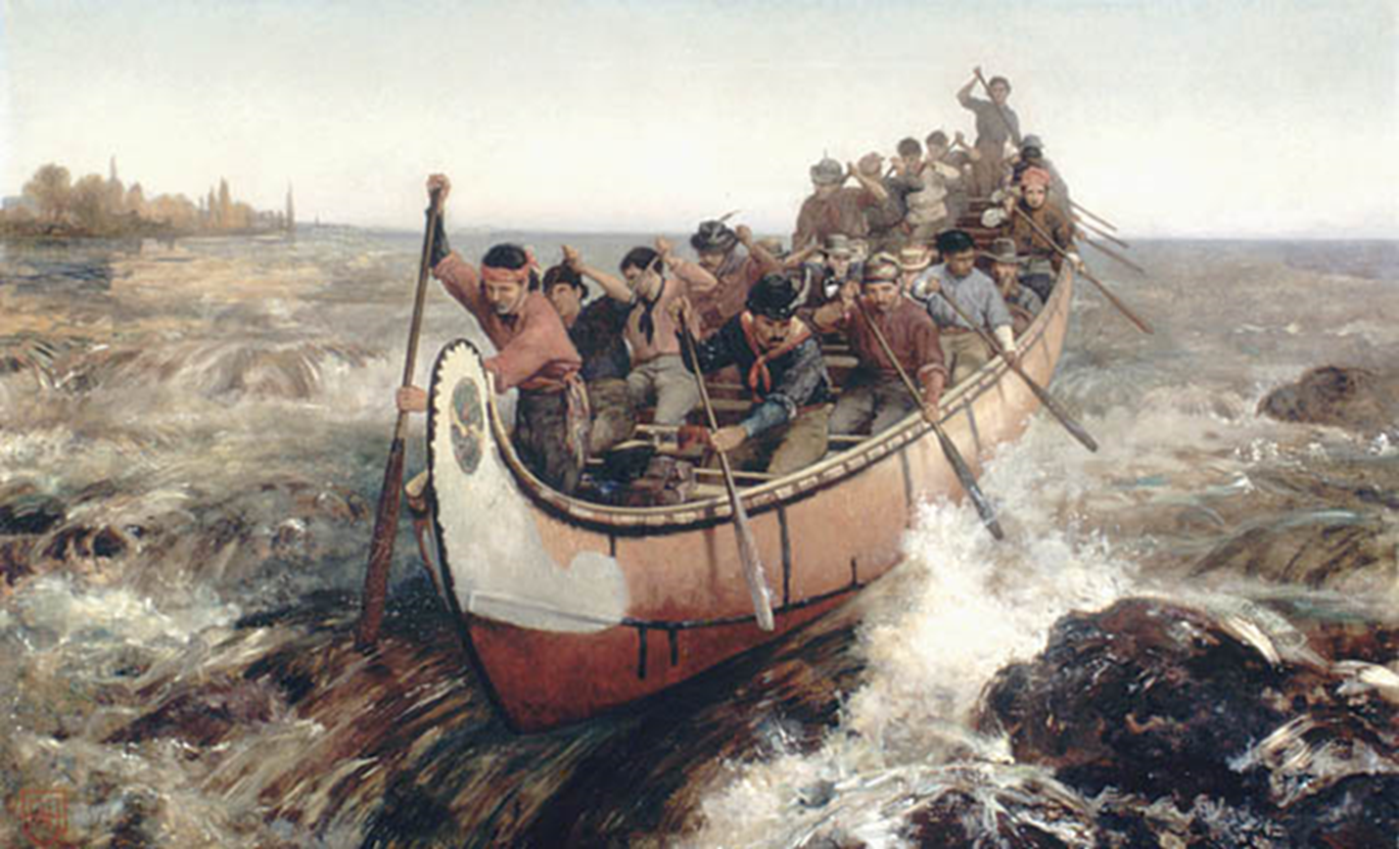
Examining Evidence - Reflection (photo)
What does/doesn’t this painting tell us about Voyageur life?

Slide 16
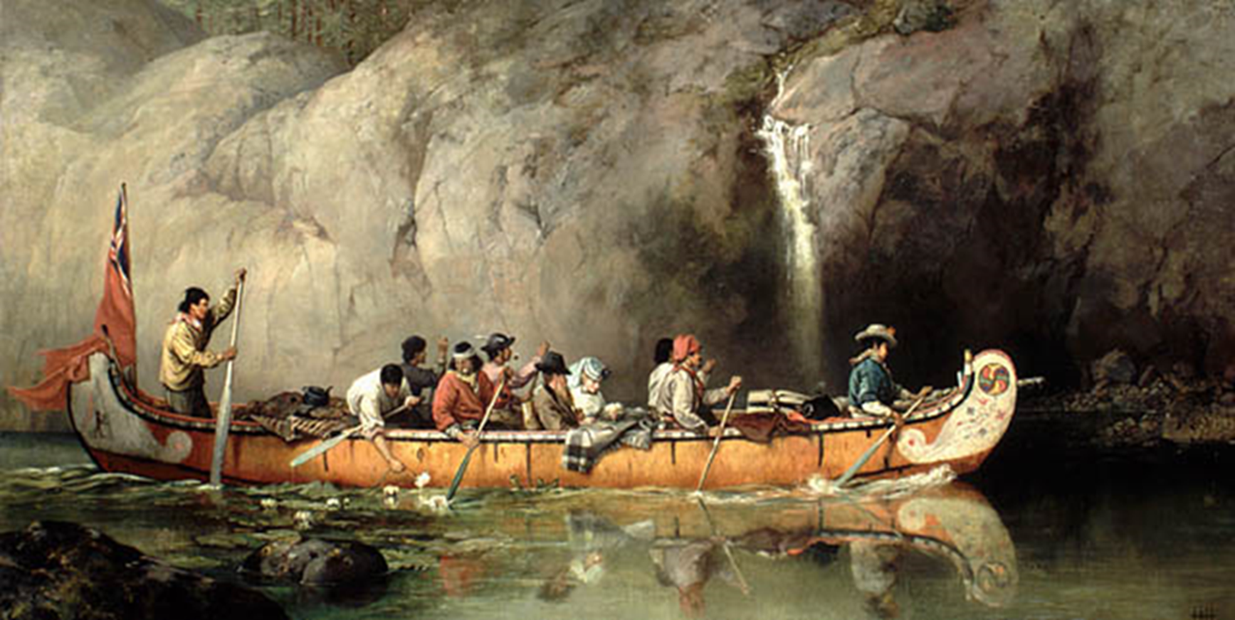
Examining Evidence - Reflection (painting from a photo)
What does/doesn’t this painting tell us about Voyageur life?

Slide 17
How reliable is the information?
4. Contestability

Slide 18
How do we better understand the people and events of the past?
5. Perspectives

Slide 19
Historical Perspective
The concept of perspective is a person’s point of view, the position from which they see and understand events going on around them.

Slide 20
Does change always been progress? How can we make sense of history?
6. Continuity and Change

Slide 21
Continuity and Change
The concept of continuity and change refers to aspects of life or society that have remained the same or changed over a period of time.
Can things change yet also retain elements of continuity?
As things have changed, have they gotten better or worse?

Slide 22
Continuity and Change- Reflection
How have children’s games changed since your grandparents played games?
To what extent was COVID a time of progress?

Slide 23
Why do events happen? What are their impacts?
7. Cause and Effect

Slide 24
Cause and Effect
where one event or action occurs as a result of the other.
What is the reason this happened?
Is there more than one reason this happened?
What impact has this event had?

Slide 25
Why might this person be feeling this way?
7. Empathy

Slide 26
Ethical Judgement - Reflection
The concept of empathy is an understanding of the past from the point of view of a particular individual or group, including an appreciation of the circumstances they faced, and the motivations, values and attitudes behind their actions.

Slide 27
Practice!!
What type of Historical Thinking do these questions individually fall under? why?
Which event leading to Canadian independence was most important?
Was Napoleon a hero or a tyrant?
To what extent was the Treaty of Versailles a cause of WWII?
To what extent was the Industrial Revolution a time of progress?
Create a time capsule with five items that represents the culture of the Metis People.
Which cause of the Great Depression was most significant?
Evaluate the challenges faced by Aboriginal people in Australia in the period 1914-2000.

